Slide 1
AQA
GCSE Physics Equations Recall Quiz

Slide 2
Paper 1 Topics 1 to 7
Equation Sheet Equations
energy = ½ x spring constant x extension²
energy = mass x SHC x temp. change
energy = mass x latent heat
pressure x volume = constant

Slide 3
Write down the equation that links……

Slide 4
1
distance
force
work done

Slide 5
2
kinetic energy
mass
speed

Slide 6
3
gravitational field strength
gravitational potential energy
height
mass

Slide 7
4
energy transferred
power
time

Slide 8
5
power
time
work done

Slide 9
6
efficiency
total input
useful output

Slide 10
7
charge flow
current
time

Slide 11
8
current
potential difference
resistance

Slide 12
9
current
potential difference
power

Slide 13
10
current
power
resistance

Slide 14
11
charge flow
energy transferred
potential difference

Slide 15
12
density
mass
volume

Slide 16
Paper 1
Answers

Slide 17
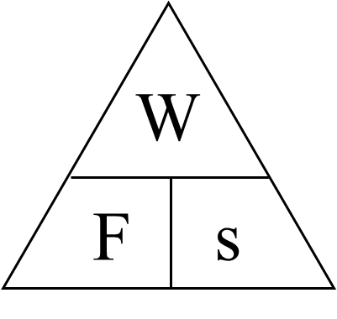
1
distance
force
work done
work done = force x distance

Slide 18
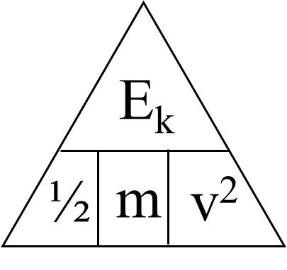
2
kinetic energy
mass
speed
kinetic energy = ½ x mass x speed²

Slide 19
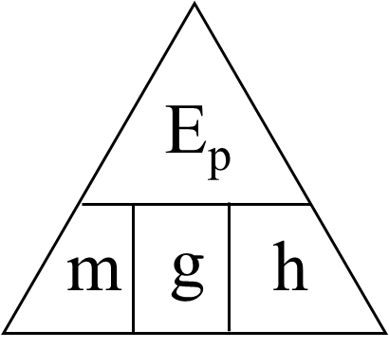
3
gravitational field strength
gravitational potential energy
height
mass
GPE = gravity x mass x height

Slide 20
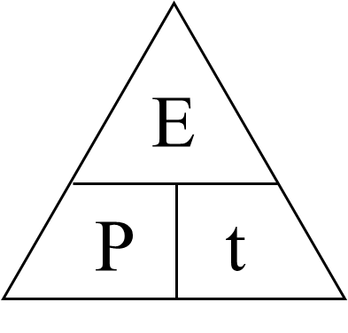
4
energy transferred
power
time
power = energy transferred / time

Slide 21
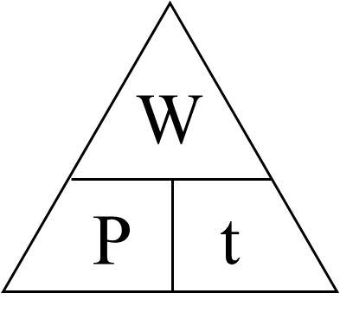
5
power
time
work done
power = work done / time

Slide 22
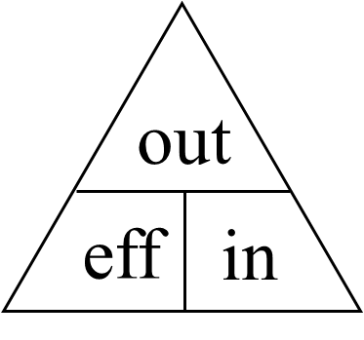
6
efficiency
total input
useful output
efficiency = useful output / total input

Slide 23
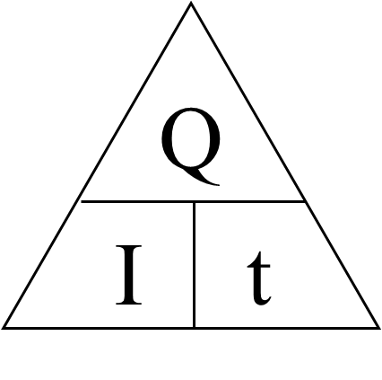
7
charge flow
current
time
charge flow = current x time

Slide 24
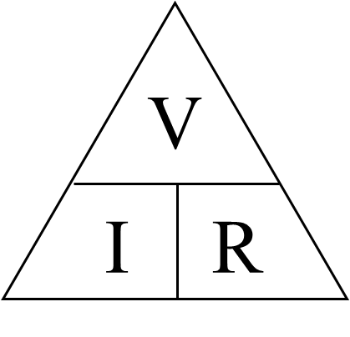
8
current
potential difference
resistance
potential difference = current x resistance

Slide 25
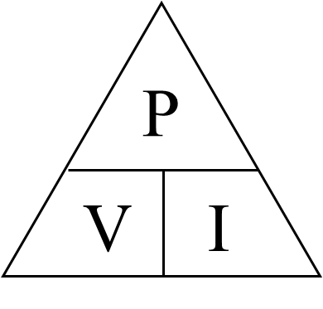
9
current
potential difference
power
power = potential difference x current

Slide 26
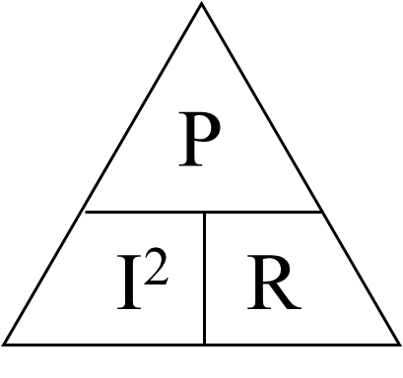
10
current
power
resistance
power = current² x resistance

Slide 27
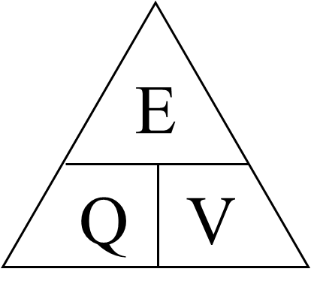
11
charge flow
energy transferred
potential difference
energy transferred = charge x p.d.

Slide 28
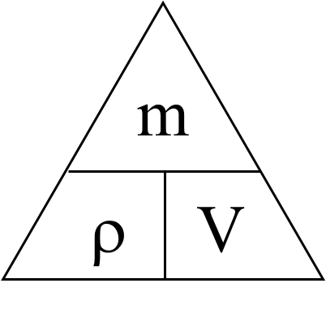
12
density
mass
volume
density = mass / volume

Slide 29
Paper 2
Topics 8 to 16
v² – u² = 2 a s
F = m Δv / Δt
p = h ρ g
T = 1 / f
m = i / o
F = B I l
V_{p} / V_{s} = n_{p} / n_{s}
V_{s} I_{s} = V_{p} I_{p}
Equation Sheet Equations

Slide 30
Write down the equation that links……

Slide 31
1
distance
force
moment

Slide 32
2
distance
speed
time

Slide 33
3
acceleration
change in velocity
time

Slide 34
4
gravitational field strength
mass
weight

Slide 35
5
extension (or compression)
force
spring constant

Slide 36
6
acceleration
force
mass

Slide 37
7
mass
momentum
velocity

Slide 38
8
area
force
pressure

Slide 39
9
frequency
wavelength
wave speed

Slide 40
Paper 2
Answers

Slide 41
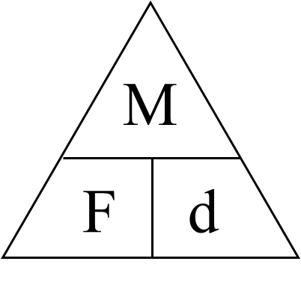
1
distance
force
moment
moment = force x distance

Slide 42
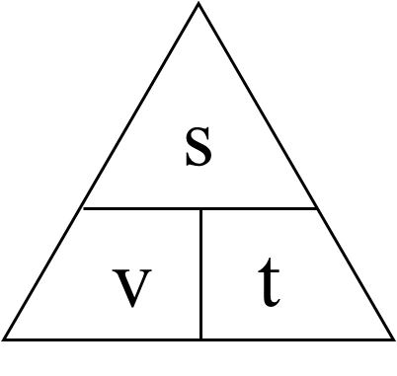
2
distance
speed
time
distance = speed x time

Slide 43
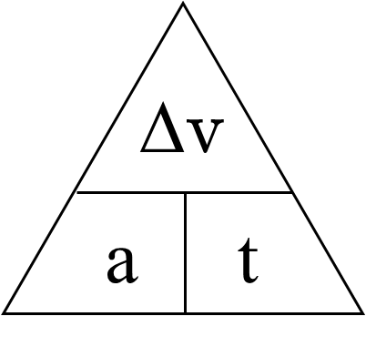
3
acceleration
change in velocity
time
acceleration = change in velocity / time

Slide 44
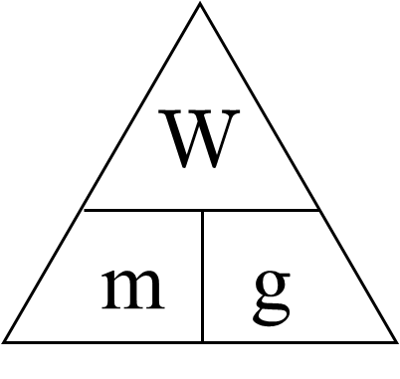
4
gravitational field strength
mass
weight
weight = mass x gravity

Slide 45
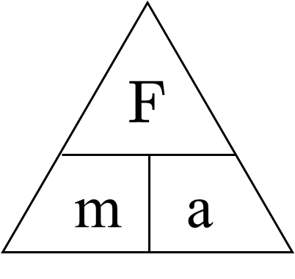
5
extension (or compression)
force
spring constant
force = spring constant x extension
k
e

Slide 46
6
acceleration
force
mass
force = mass x acceleration

Slide 47
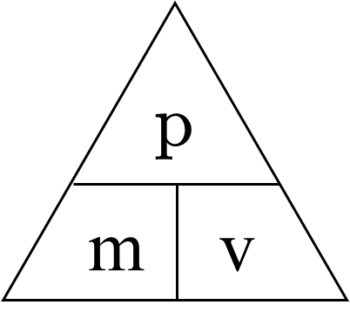
7
mass
momentum
velocity
momentum = mass x velocity

Slide 48
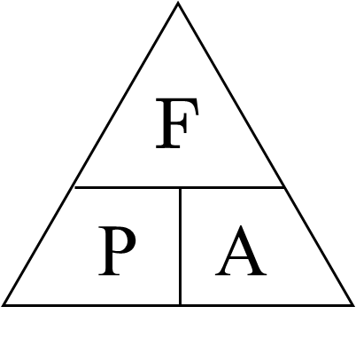
8
area
force
pressure
pressure = force / area

Slide 49
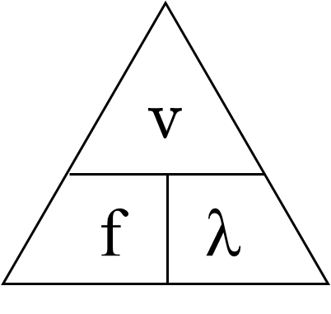
9
frequency
wavelength
wave speed
wave speed = frequency x wavelength

Slide 50
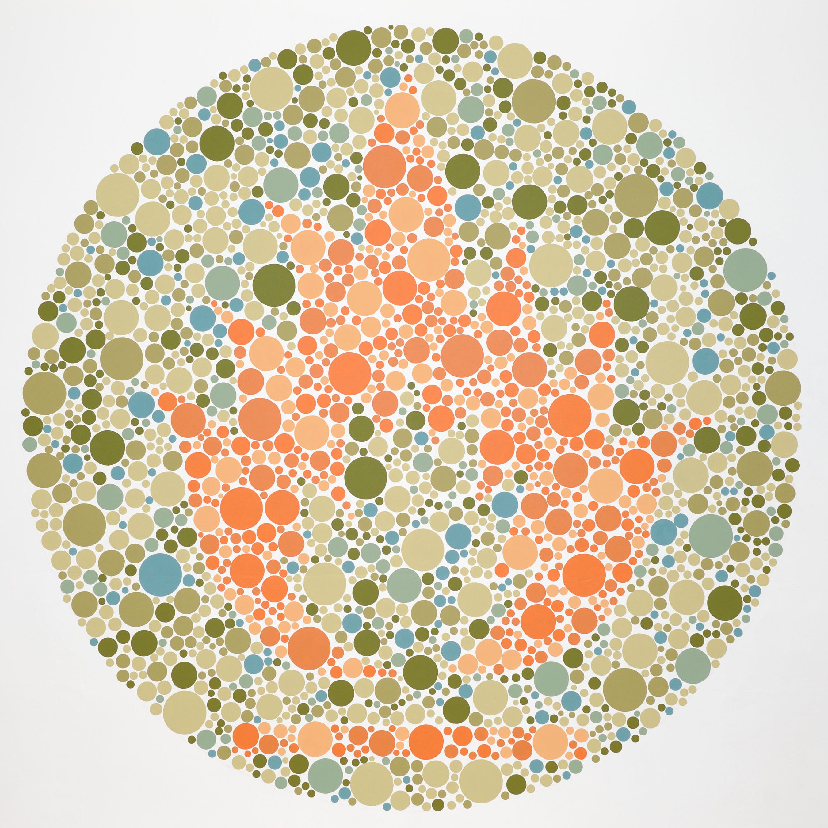
tiny.cc/sapa

